Slide 1


Slide 2

Azure serverless for IT-Pro

Slide 3
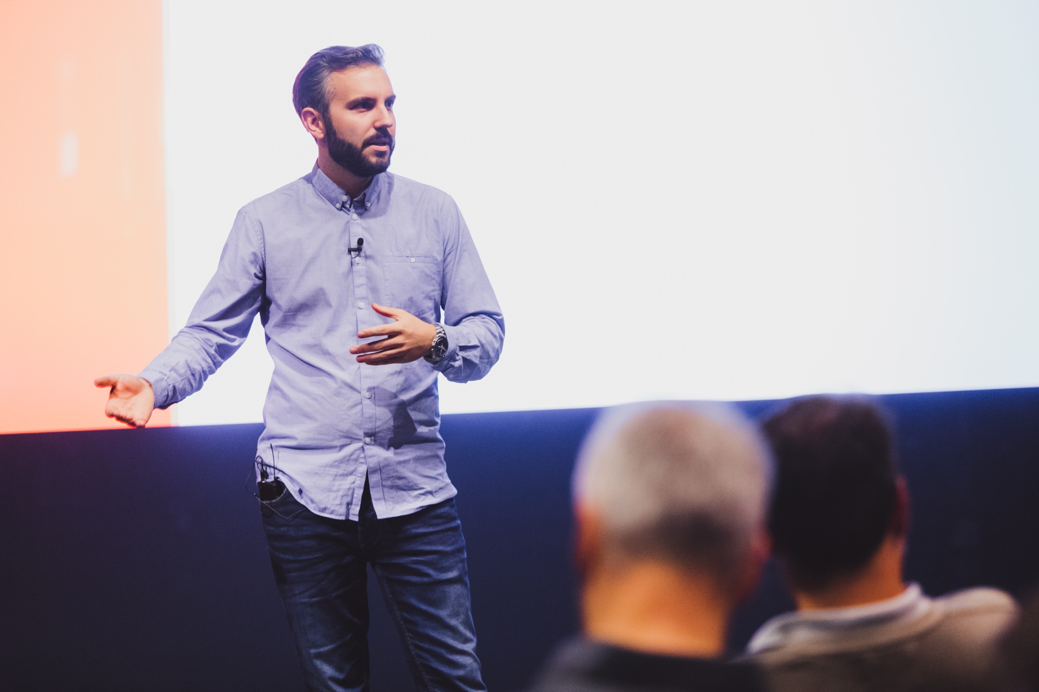

Martin Ehrnst
Height: below average
Age: Around 30
Beer or wine: both
Interests: Cars, and alpine skiing
Employer: Intility
Azure
@ehrnst
martinehrnst
Adatum.no
ehrnst

Slide 4
Serverless for IT Pros: Agenda
Automation trends
Event driven automation
Event Grid
Logic Apps
Azure Functions

Slide 5
Trends in automation
DevOps method
APIs everywhere
More complex environments
Multi/hybrid cloud
Shared responsibility
Shared technology stack

Slide 6
Q: Name two languages you need to write, and read as an IT Pro today
JSON PowerShell

Slide 7
Q: Name two languages you need to write, and read as an IT Pro today
JSON PowerShell

Slide 8
Event driven automation

Slide 9
Event driven automation
An event represents change in state
Act on the state changes in “real time”
Ideal for integration between multiple sub systems
Highly scalable

Slide 10
Event driven automation- examples
Business process automation
React to new infrastructure deployments.
Alerting- for example to IM
Security remediation

Slide 11
Azure Event Grid

Slide 12
Azure Event Grid
Fully managed service for event routing
Uses a publish-subscribe model
Event publishers, event handlers
Ideal for reactive scenarios

Slide 13
Five concepts of Event Grid
Events: What happened
Source: Where did it happen
Topics: Where events are published
Event Subscriptions: routing and filtering
Handlers: your code/app reacting to the event

Slide 14

Event flow
Resource group
Storage
Azure Functions
Logic Apps
Azure Subscriptions
Custom topic
Azure Automation
Webhooks
Event publishers
Event subscribers

Slide 15
Event subscription filters
Event types
Event subject
Advanced fields and operators
Azure Functions
Logic Apps
Azure Automation
Webhooks
Event subscribers
Filter options

Slide 16
Event subscription filters
"Microsoft.Resources.ResourceWriteSuccess"
Azure Functions
Logic Apps
Azure Automation
Webhooks
Event subscribers
Example: event type filter

Slide 17
Logic Apps

Slide 18
Logic Apps
Orchestration engine
Works cross clouds and on prem
No code required
300+ built in connectors

Slide 19
Send alert to Teams
Martin Ehrnst

Slide 20
Azure Functions

Slide 21
Azure Functions overview
Run small code pieces on demand or scheduled
Supports many languages- including PowerShell
Integrates with Azure, on-prem and other clouds

Slide 22
React to infrastructure changes

Slide 23
Scenario: Pizza ordering process

Slide 24
Demo
Martin Ehrnst

Slide 25
Demo summary
"Microsoft.Resources.ResourceWriteSuccess"

Slide 26
Demo summary
"Microsoft.Resources.ResourceWriteSuccess"

Slide 27
Demo summary
"Microsoft.Resources.ResourceWriteSuccess"

Slide 28
Demo
Martin Ehrnst

Slide 29
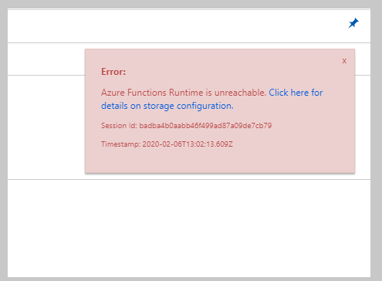
Demo
Martin Ehrnst

Slide 30
Scenario: Pizza ordering process
resourceGroup created

Slide 31
Scenario: Pizza ordering process
resourceGroup created
Send to subscriber

Slide 32
Scenario: Pizza ordering process
resourceGroup created
Send to subscriber
Process event

Slide 33
Scenario: Pizza ordering process
resourceGroup created
Send to subscriber
Process event
Apply tags

Slide 34

Scenario: Pizza ordering process
resourceGroup created
Send to subscriber
Process event
Apply tags
Governance

Slide 35

Last slide!
Make serverless boost your career!
Event driven automation makes it easy to change small pieces of your process.
Use Functions and other Azure tools on-prem

Slide 36
Slides and demos from the conference will be available at
https://github.com/nordicinfrastructureconference/2020
A demo using event grid and Azure functions for custom events
https://github.com/ehrnst/AzureFunctions-EventGrid-Demo

